Slide 1




SHRI GURU GOBIND SINGH JI GOVT. COLLEGE,
PAONTA SAHIB, SIRMOUR (H.P)

Slide 2
DR. KIRAN BALA SHARMA
(ASSTT. PROF. MUSIC INSTRUMENTAL) H.O.D.
MR. RAVINDER SHARMA
(ASSTT. PROF. MUSIC VOCAL)

Slide 3


Slide 4



Slide 5
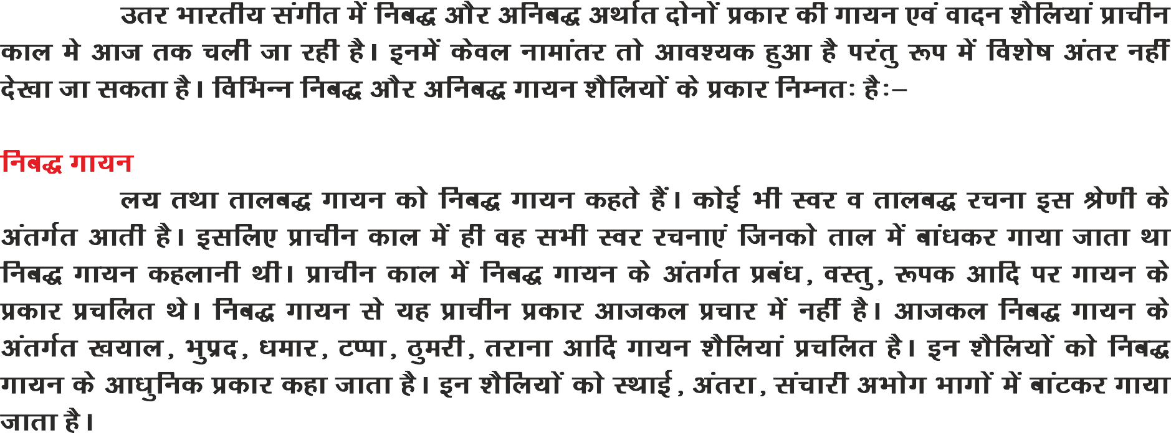

Slide 6
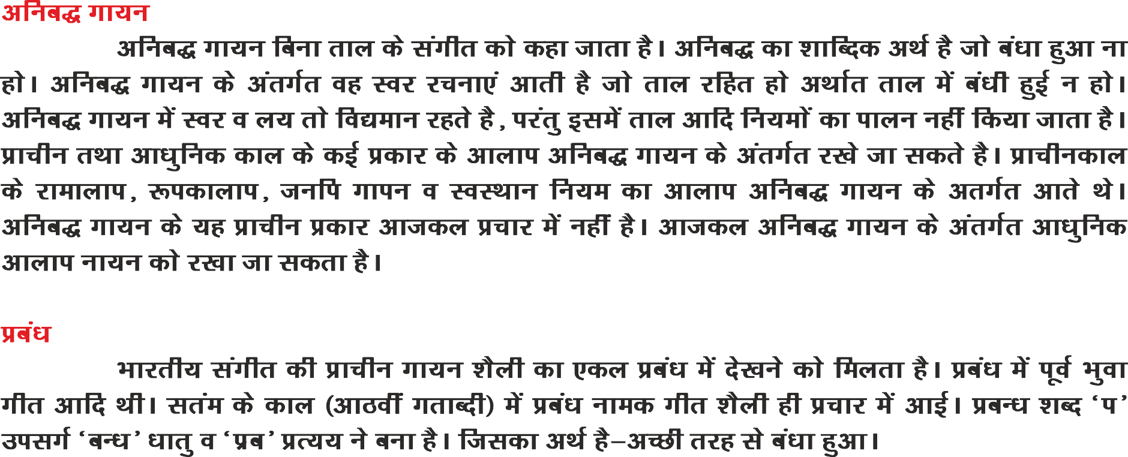

Slide 7


Slide 8


Slide 9
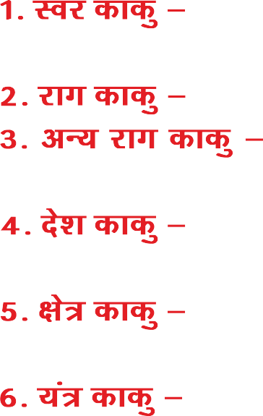
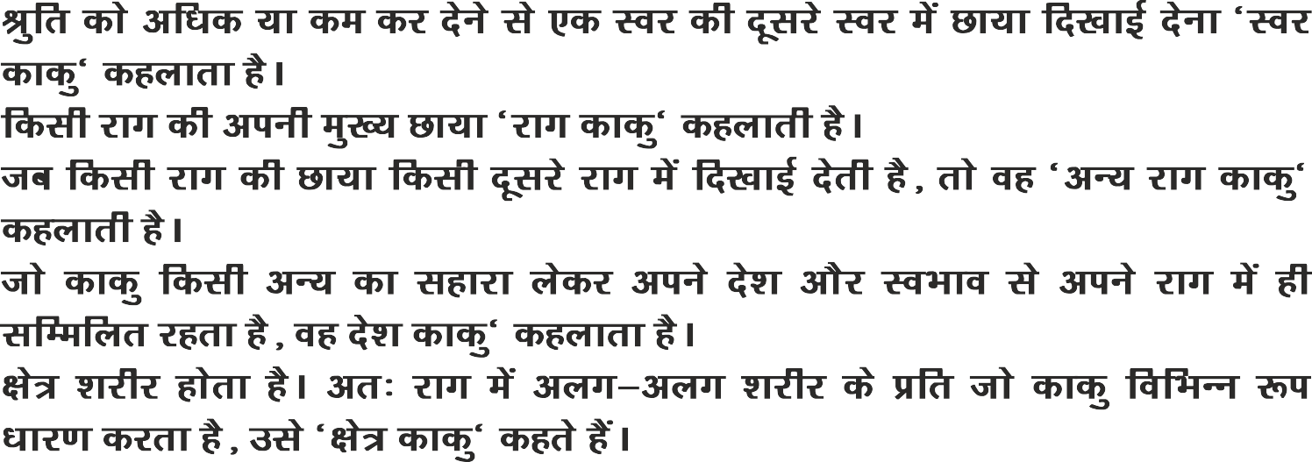

Slide 10


Slide 12


Slide 13

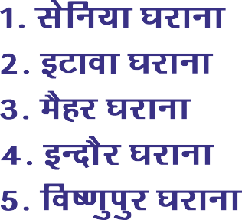

Slide 14
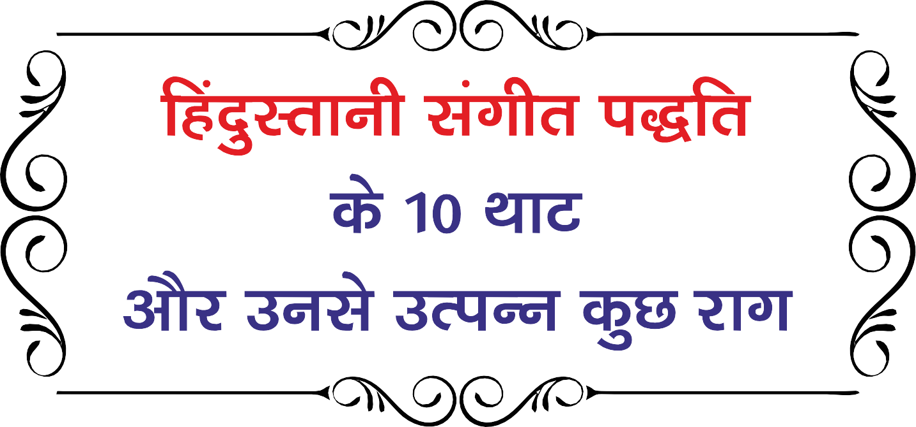

Slide 15
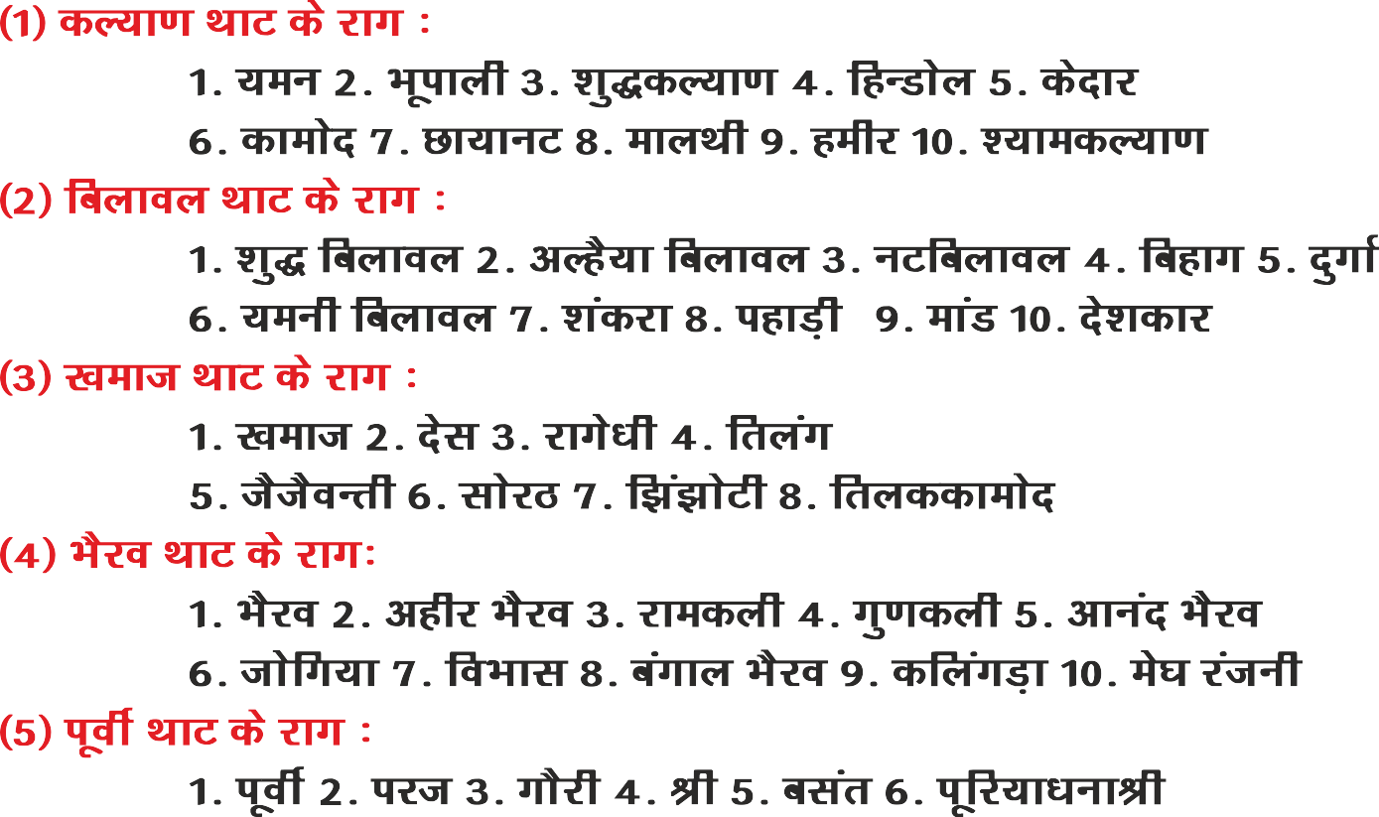

Slide 16
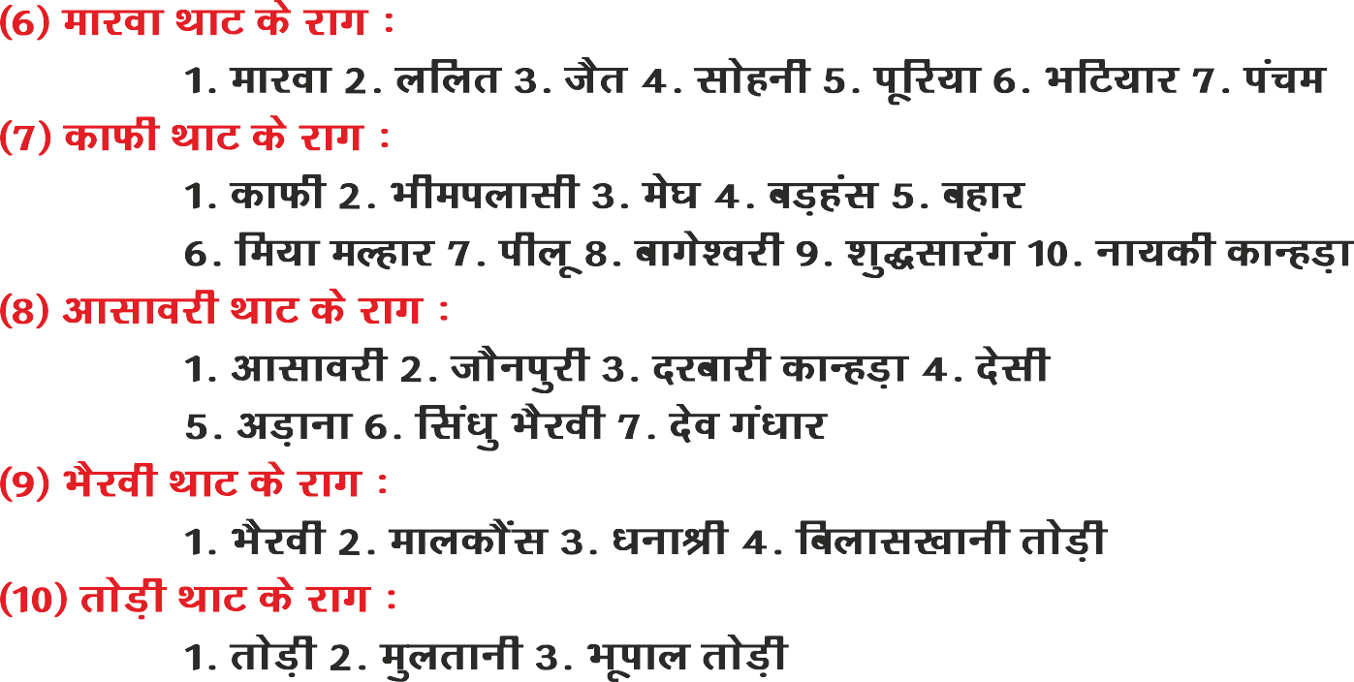

Slide 17
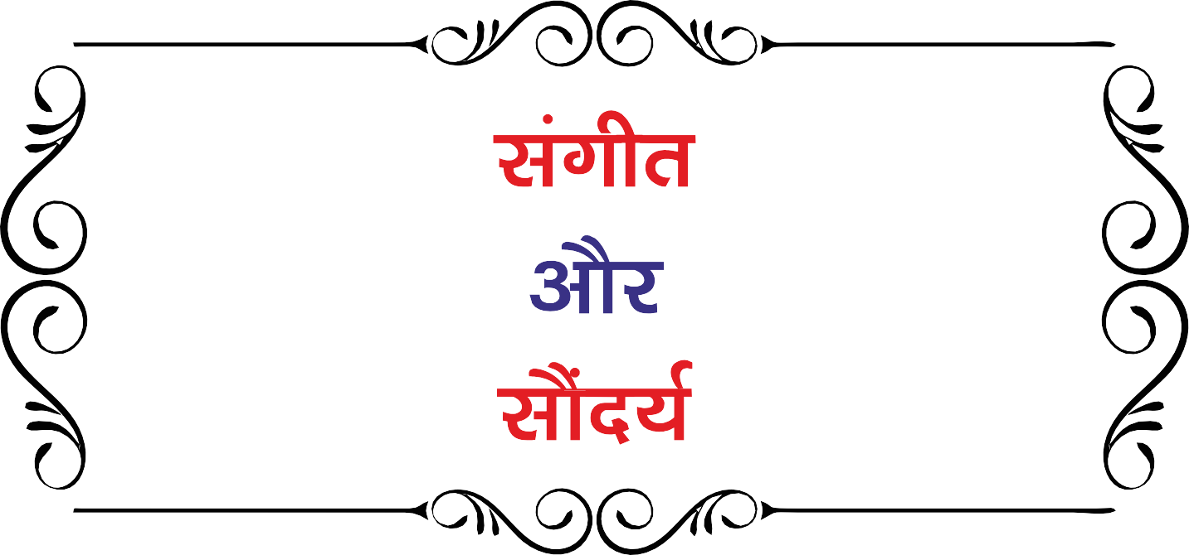

Slide 18



Slide 19
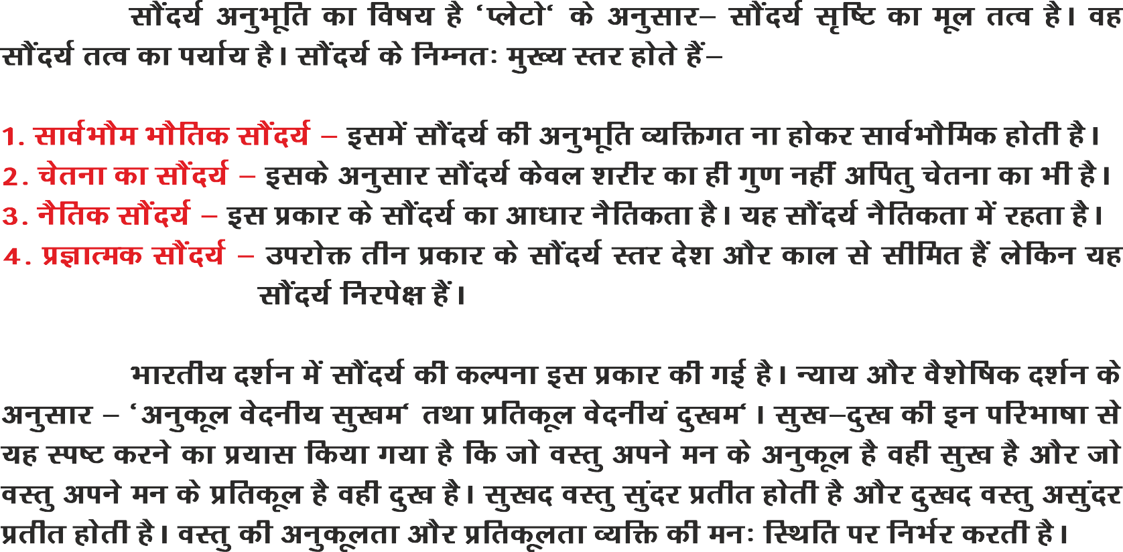

Slide 20


Slide 21


Slide 22


Slide 23


Slide 24

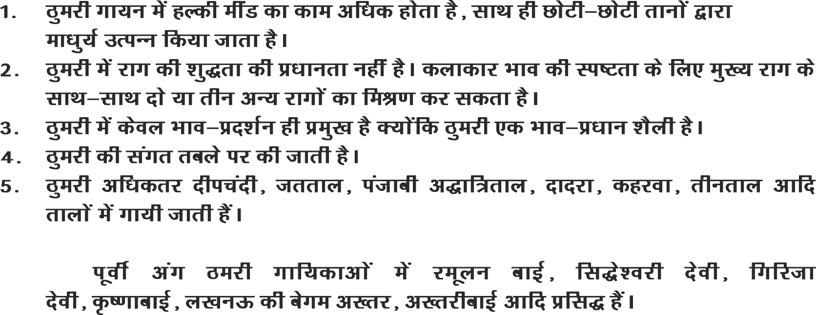

Slide 25
THANK YOU

